Slide 1

everyone

Slide 2



S(t)imulating European Identity
3rd Transnational Meeting 29/10/2018 – 02/11/2018, Nummela, Finland

Slide 3


Slide 4


Slide 5
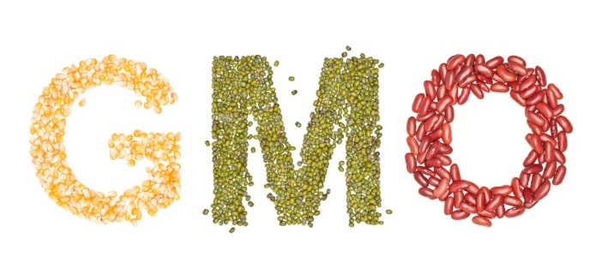
Genetically Modified Organisms
Notes:
First, let’s set clear what the acronym GMOs stands for...

Slide 6

Genetically Modified organisms

Slide 7
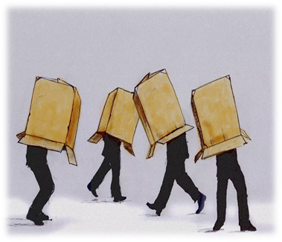

Ignorance vs. Knowledge
Ignorance
Notes:
What we have just watched is part of most people’s everyday life. It’s reasonable to feel scared or insecure. However, the danger we sense does not come from the evolution of science or technology itself. It’s ignorance which brings us to conflict situations.

Slide 8
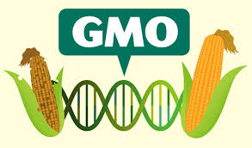
What are GMOs?
Genetically Modified Organisms:
Organisms the DNA of which has been changed by the means of a laboratory process of taking genes from one species and inserting them into another in order to obtain a desired trait, that is a characteristic.

Slide 9
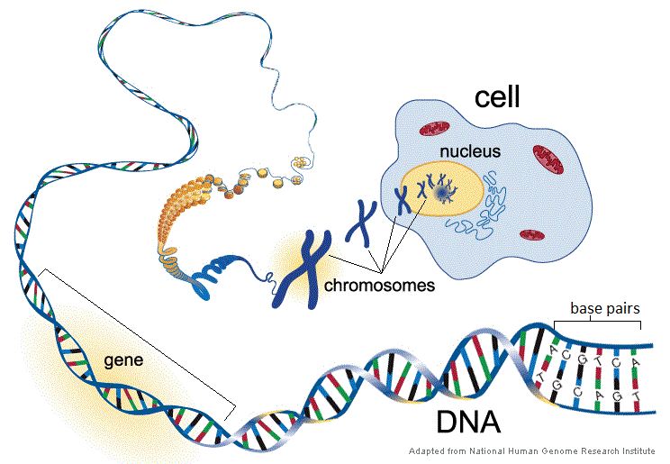
What is DNA?
Notes:
DNA is a long molecule contained in the nucleus of the cells of eukaryotes and the cellular cytoplasm of prokaryotes carrying the genetic instructions used in the growth, development, functioning and reproduction of all organisms and many viruses. Its length is almost 2m in humans. DNA gets organised into structures called chromosomes and manages to fit in the nucleus of eukaryotes, that is organisms composed of cells containing nuclei, by tightly winding around special proteins.

Slide 10
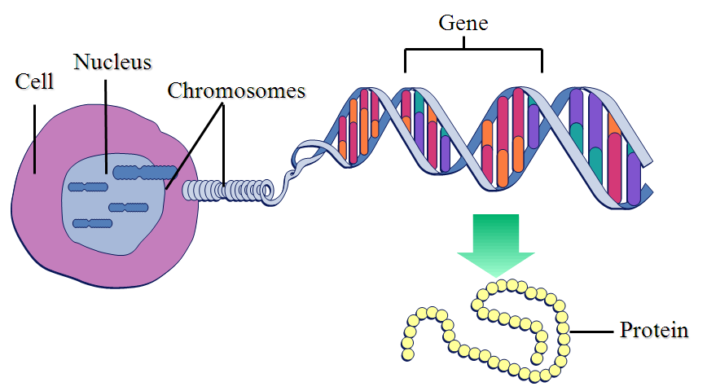
What is a gene?
A gene is a sequence of DNA that codes for a protein and thus determines a trait.
Notes:
Genes are segments of DNA located in chromosomes and containing the instructions for protein production. They exist in more than one form and determine distinct traits that can be passed on from parents to offspring.

Slide 11
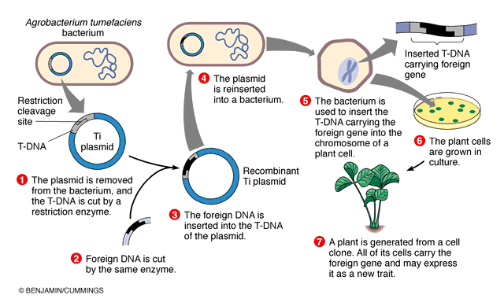
How are plants genetically modified?
Notes:
But how are plants genetically modified? Well, a special bacterium, known as Agrobacterium, is used. That has the ability to transfer DNA between itself and plants. Its cell contains a bacterial chromosome and a Tumor inducing plasmid, also called Ti plasmid. Firstly, this plasmid is removed from the bacterium and the T-DNA - Transfer DNA - is cut by a restriction enzyme. Then the foreign DNA which has the required trait is cut by the same enzyme and inserted into the Ti plasmid. After that, the plasmid is reinserted into the bacterium which will be used to insert the DNA carrying the foreign gene into the chromosome of a plant cell. Next, the plant cells are grown in culture. Finally, a plant is generated from a cell clone, all of the cells of which carry the foreign gene and may express it as a new trait.

Slide 12
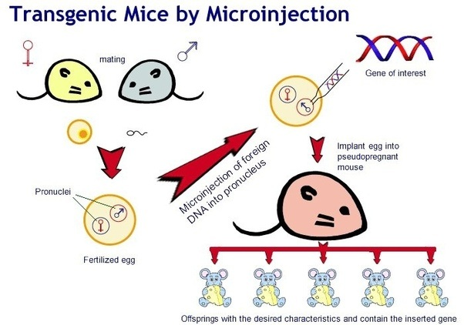
How are animals genetically modified?
Notes:
As for animals, the most common method for producing GM ones is to inject the foreign gene into fertilised eggs through a process known as “microinjection”. For mammals, the injected eggs are placed into a “foster” mother where they develop to term. If the foreign gene has been successfully incorporated into the egg’s original DNA, the resultant offspring will carry the extra, foreign DNA. When this GM animal mates and produces offspring, the foreign gene is inherited in the same way as the normal DNA. In this way, scientists can breed a line of GM animals that carries the extra DNA. You can see a diagrammatic representation of the technique in the picture.

Slide 13
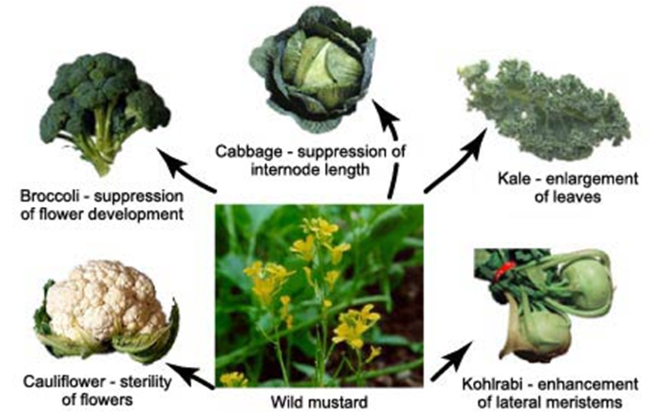
Is DNA alteration a recent phenomenon?
DNA changes have been happening during the evolution of species due to natural selection.
Humans have been altering
the DNA sequence of crops
over the years for the
purposes of agricultural
development
(artificial selection)

Slide 14

What is the difference?
Laboratory genetic modification is the first attempt to combine genetic materials that would never naturally match.

Slide 15
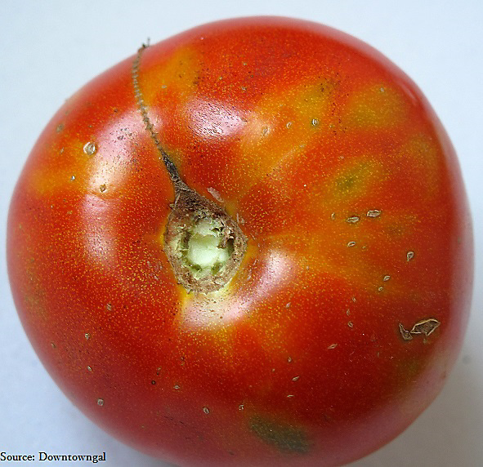
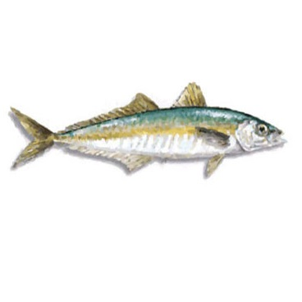
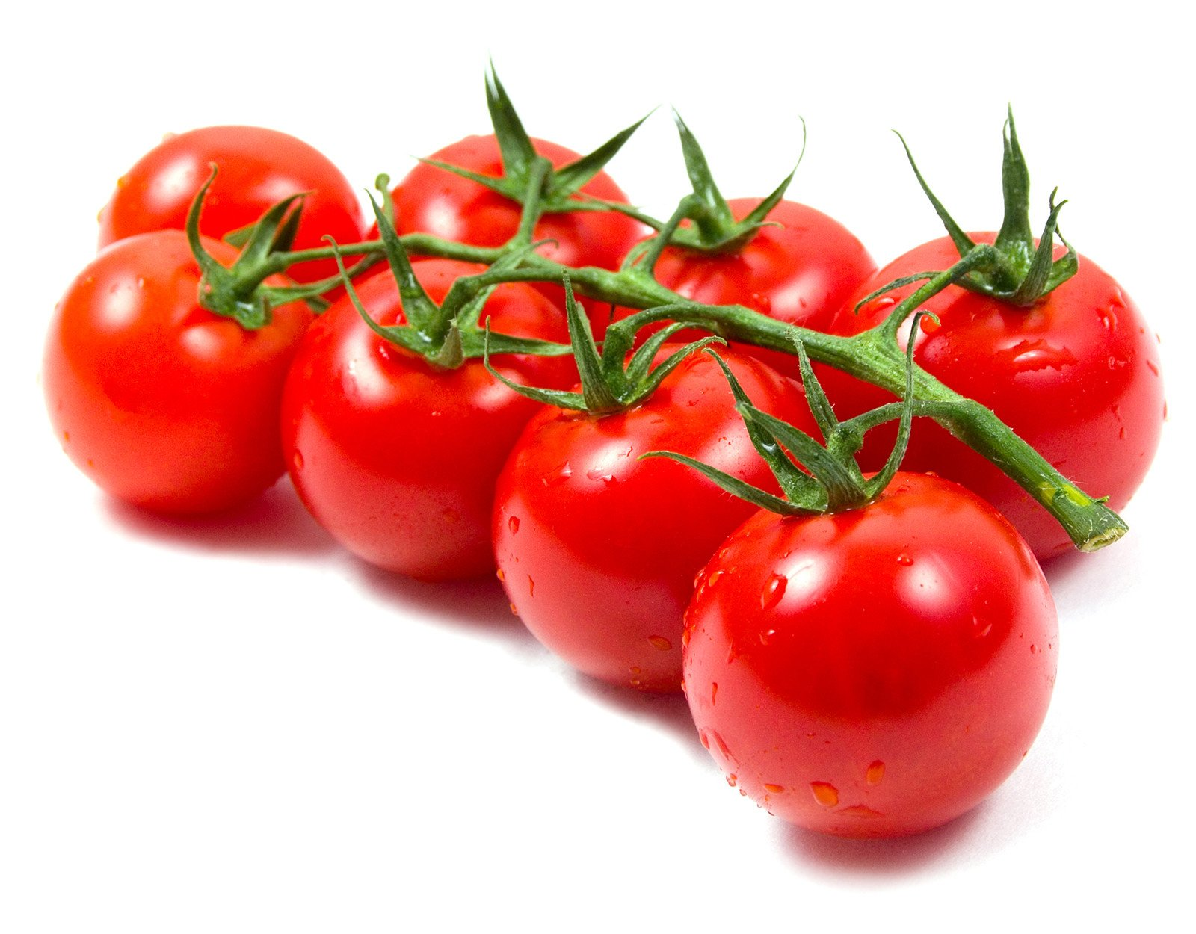
1st Example
Tomatoes which contain cold-water fish genes. These genes make tomatoes more resistant to low temperatures.

Slide 16
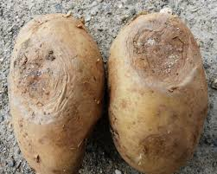
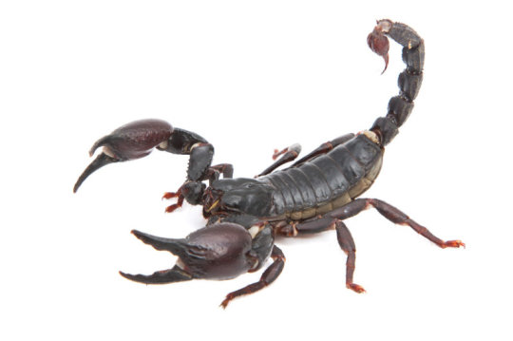
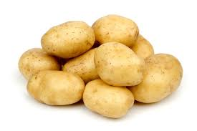
2nd Example
Potatoes which contain scorpion genes. These genes cause the production of the scorpion poison. Potatoes become resistant to insects.

Slide 17
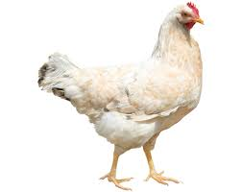
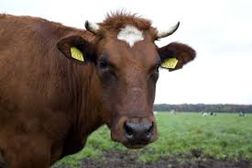
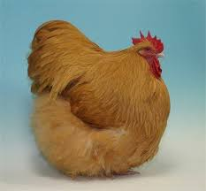
3rd Example
Chickens which contain beef genes.
These genes cause the production of beefs’ augmentative hormones.
The chicken becomes bigger than a normal one and contains less fat.

Slide 18

It’s important to know that science is still studying the effects of GMO on our health.
There isn’t enough evidence to prove that GMOs can worsen our health.

Slide 19


Slide 20
References
http://www.scidev.net/global/gm/news/gm-potato-uses-frog-gene-to-resist-pathogens.html
https://www.food.gov.uk/business-industry/exports
https://www.food.gov.uk/business-industry/imports
https://www.food.gov.uk/business-industry/imports
http://www.hawaiiseed.org/about-gmos/antibiotic-resistance/
https://www.organicconsumers.org/old_articles/ge/allergies111603.php
https://occupytheory.org/advantages-and-disadvantages-of-genetically-modified-foods/
https://caloriebee.com/nutrition/geneticallymodifiedfood
https://epthinktank.eu/2015/02/12/new-gmo-legislation/

Slide 21
http://www.kidsrighttoknow.com/gmos/ https://www.nature.com/scitable/topicpage/dna-is-a-structure-that-encodes-biological-6493050 https://www.nature.com/scitable/topicpage/dna-packaging-nucleosomes-and-chromatin-310 http://www.open.edu/openlearn/science-maths-technology/science/tour-the-cell/content-section-4.3.1 https://www.livescience.com/37247-dna.html https://geneed.nlm.nih.gov/topic_subtopic.php?tid=15&sid=16 https://quizlet.com/10758957/biology-protein-synthesis-quiz-flashcards-flash-cards/ https://www.thoughtco.com/genes-373456 http://sphweb.bumc.bu.edu/otlt/mph-modules/ph/gmos/gmos_print.html http://sitn.hms.harvard.edu/flash/2015/from-corgis-to-corn-a-brief-look-at-the-long-history-of-gmo-technology/ https://www.pri.org/stories/2016-01-13/researchers-around-world-are-exploring-how-gmo-technology-might-boost-food https://www.newportnaturalhealth.com/2013/07/gmos-the-pros-cons-of-genetically-modified-food/ https://www.biofortified.org/2015/12/gmos-and-patents-part-1-terminator-genes/

Slide 22

"The European Commission support for the production of this publication does not constitute an endorsement of the contents which reflects the views only of the authors, and the Commission cannot be held responsible for any use which may be made of the information contained therein".

